Slide 1
Cheshire & Merseyside – GP Survey 2022 Summary by Place

Slide 2
Place Summary Metrics

Slide 3
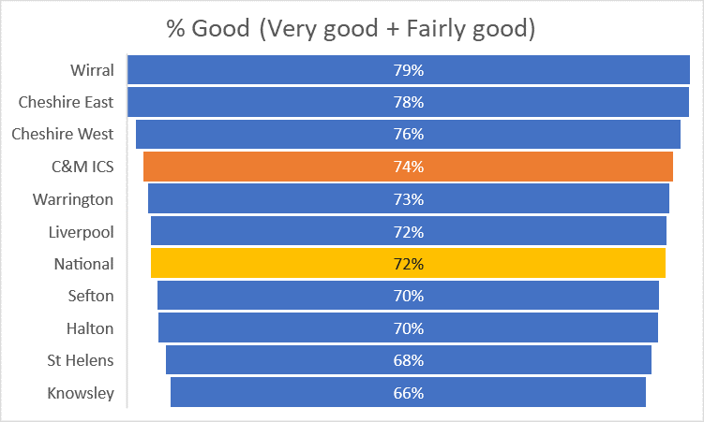
Overall experience Q32. Overall, how would you describe your experience of your GP practice?

Slide 4
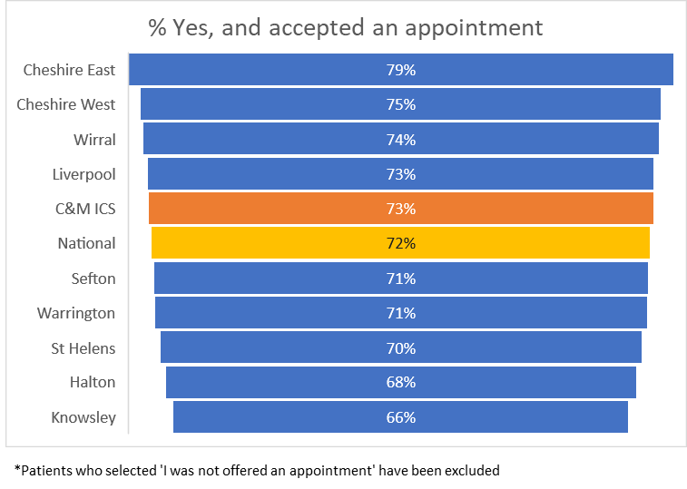
Making an appointment Q16. Were you satisfied with the appointment (or appointments) you were offered?

Slide 5
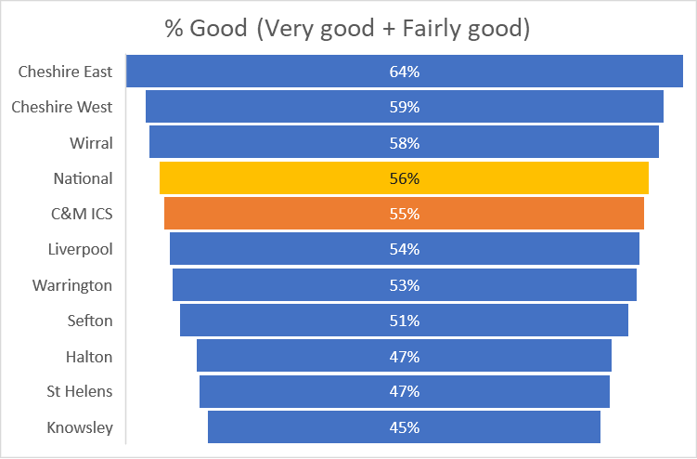
Making an appointment Q21. Overall, how would you describe your experience of making an appointment?

Slide 6
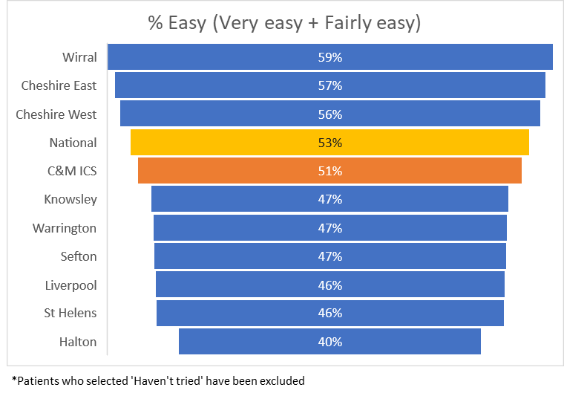
Local GP services Q1. Generally, how easy is it to get through to someone at your GP practice on the phone?

Slide 7
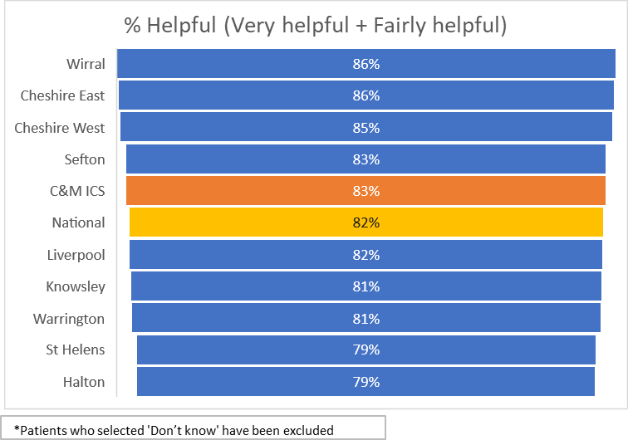
Local GP services Q2. How helpful do you find the receptionists at your GP practice?

Slide 8
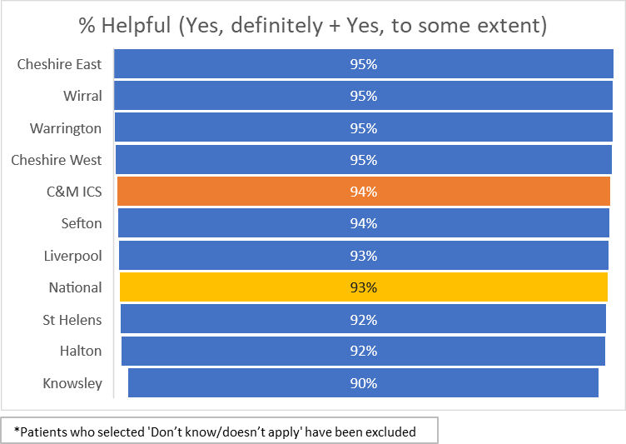
Local GP services Q30. During your last general practice appointment, did you have confidence and trust in the healthcare professional you saw or spoke to?

Slide 9
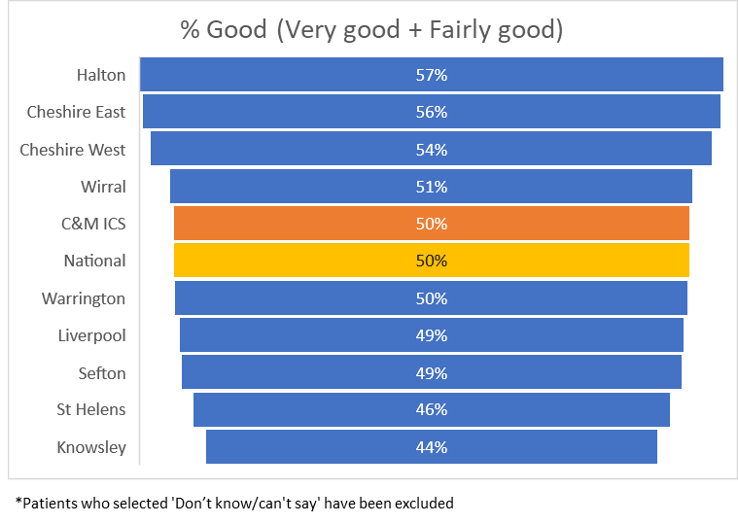
Local GP services Q47. Overall, how would you describe your last experience of NHS services when you wanted to see a GP but your GP practice was closed?

Slide 10
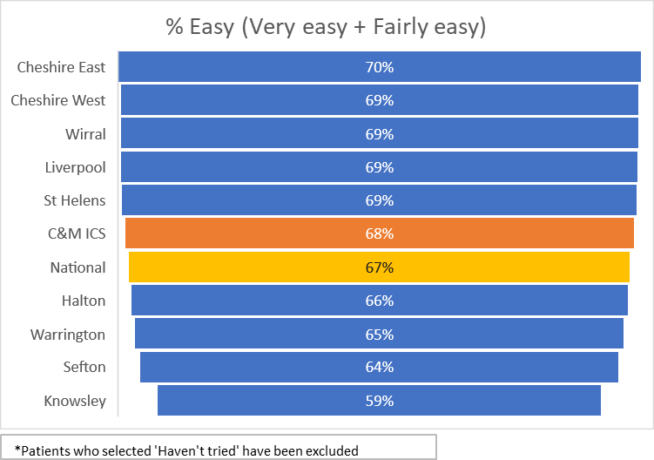
Access to on-line services Q4. How easy is it to use your GP practice’s website to look for information or access services?

